Slide 1



Firestore
CRUD
PERTEMUAN 12 MOBILE PROGRAMMING 1
Nova Agustina, M.Kom.
Tools :

Slide 2


KONTRAK KULIAH
PRESENSI
UTS
UAS
TUGAS
QUIZ
ABSEN
UTS
20%
25%
?%
30%
10%
15%
100

Slide 3


TUJUAN
Mampu memahami dan mengimplementasi penambahan data, perubahan dan penghapusan data yang dinamis dengan Firestore
Melakukan pelaporan dan pencatatan progres Tubes (Elearning)

Slide 4
CRUD Firestore SESI 12

Slide 5
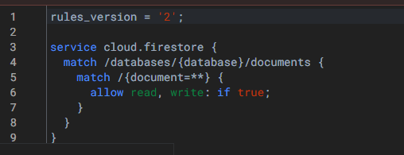
Android Manifest
Ubah Rules pada Firestore Database, menjadi true

Slide 6
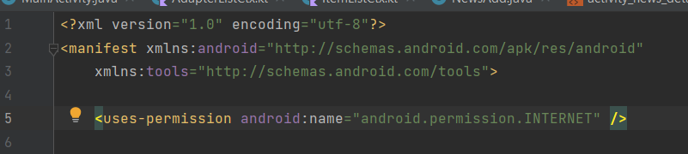
Android Manifest
Tambahkan permission internet pada Android Manifest

Slide 7
Create Data
Import implementation("com.google.firebase:firebase-firestore") pada Build Gradle Module
Impoer implementation("com.github.bumptech.glide:glide:4.16.0") pada dependencies pada Build Gradle Module
Sync Now
Buka dokumentasi CRUD Firestore: https://firebase.google.com/docs/firestore/quickstart#android

Slide 8
CRUD Firestore (COLLECTION DATA) / SIMPAN DAN EDIT DATA

Slide 9
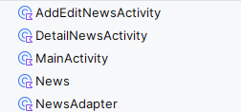
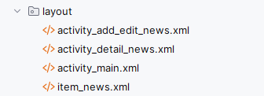
Create Data
Buat Empty Activity baru dengan nama
AddEditNewsActivity
DetailNewsActivity
Buat Data Class baru dengan nama
News
Buat Class baru dengan nama
NewsAdapter

Slide 10
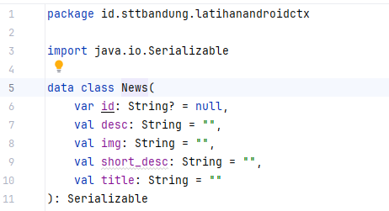
Read Data
Pada News,tambahkan

Slide 11
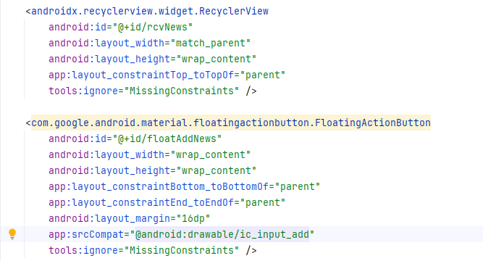
Create Data
Pada activity_main.xml tambahkan recycleriew dan floating button. Dapat copy source di bawah ini:
<?xml version="1.0" encoding="utf-8"?>
<androidx.constraintlayout.widget.ConstraintLayout xmlns:android="http://schemas.android.com/apk/res/android"
xmlns:app="http://schemas.android.com/apk/res-auto"
xmlns:tools="http://schemas.android.com/tools"
android:layout_width="match_parent"
android:layout_height="match_parent"
android:layout_margin="10dp"
tools:context=".MainActivity">
<androidx.recyclerview.widget.RecyclerView
android:id="@+id/rcvNews"
android:layout_width="match_parent"
android:layout_height="wrap_content"
app:layout_constraintTop_toTopOf="parent"
tools:ignore="MissingConstraints" />
<com.google.android.material.floatingactionbutton.FloatingActionButton
android:id="@+id/floatAddNews"
android:layout_width="wrap_content"
android:layout_height="wrap_content"
app:layout_constraintBottom_toBottomOf="parent"
app:layout_constraintEnd_toEndOf="parent"
android:layout_margin="16dp"
app:srcCompat="@android:drawable/ic_input_add"
tools:ignore="MissingConstraints" />
</androidx.constraintlayout.widget.ConstraintLayout>

Slide 12
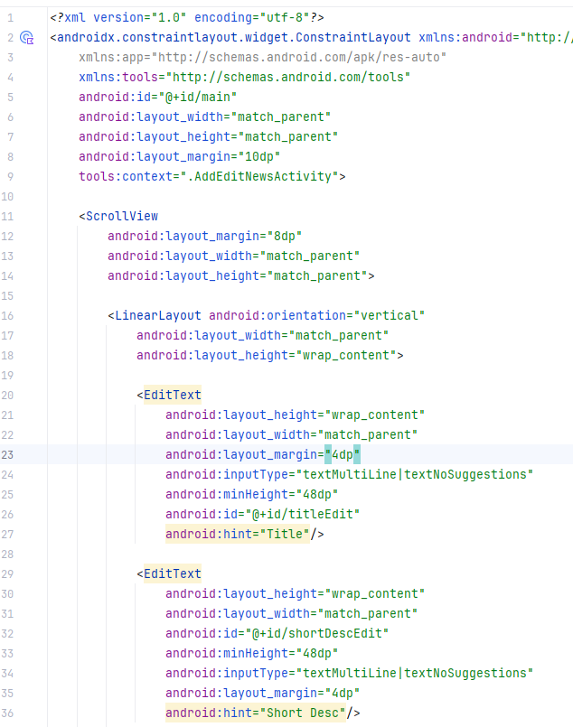
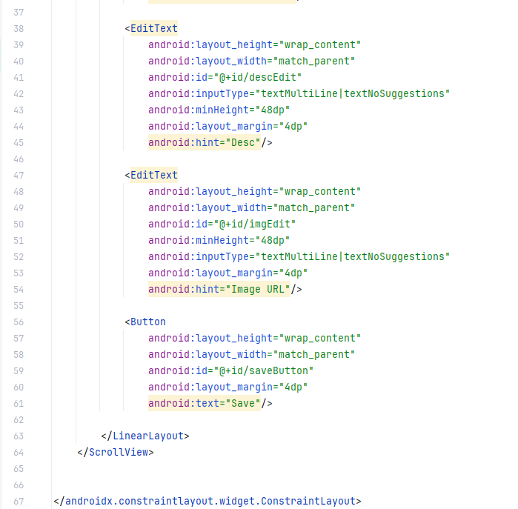
Create Data
Pada activity_add_edit_news.xml source berikut
<?xml version="1.0" encoding="utf-8"?>
<androidx.constraintlayout.widget.ConstraintLayout xmlns:android="http://schemas.android.com/apk/res/android"
xmlns:app="http://schemas.android.com/apk/res-auto"
xmlns:tools="http://schemas.android.com/tools"
android:id="@+id/main"
android:layout_width="match_parent"
android:layout_height="match_parent"
android:layout_margin="10dp"
tools:context=".AddEditNewsActivity">
<ScrollView
android:layout_margin="8dp"
android:layout_width="match_parent"
android:layout_height="match_parent">
<LinearLayout android:orientation="vertical"
android:layout_width="match_parent"
android:layout_height="wrap_content">
<EditText
android:layout_height="wrap_content"
android:layout_width="match_parent"
android:layout_margin="4dp"
android:inputType="textMultiLine|textNoSuggestions"
android:minHeight="48dp"
android:id="@+id/titleEdit"
android:hint="Title"/>
<EditText
android:layout_height="wrap_content"
android:layout_width="match_parent"
android:id="@+id/shortDescEdit"
android:minHeight="48dp"
android:inputType="textMultiLine|textNoSuggestions"
android:layout_margin="4dp"
android:hint="Short Desc"/>
<EditText
android:layout_height="wrap_content"
android:layout_width="match_parent"
android:id="@+id/descEdit"
android:inputType="textMultiLine|textNoSuggestions"
android:minHeight="48dp"
android:layout_margin="4dp"
android:hint="Desc"/>
<EditText
android:layout_height="wrap_content"
android:layout_width="match_parent"
android:id="@+id/imgEdit"
android:minHeight="48dp"
android:inputType="textMultiLine|textNoSuggestions"
android:layout_margin="4dp"
android:hint="Image URL"/>
<Button
android:layout_height="wrap_content"
android:layout_width="match_parent"
android:id="@+id/saveButton"
android:layout_margin="4dp"
android:text="Save"/>
</LinearLayout>
</ScrollView>
</androidx.constraintlayout.widget.ConstraintLayout>

Slide 13
Create Data
Pada MainActivity import beberapa library yang akan digunakan
import android.content.Intent
import android.os.Bundle
import android.util.Log
import android.widget.Toast
import androidx.appcompat.app.AppCompatActivity
import androidx.recyclerview.widget.LinearLayoutManager
import androidx.recyclerview.widget.RecyclerView
import com.google.android.material.floatingactionbutton.FloatingActionButton
import com.google.firebase.firestore.ktx.firestore
import com.google.firebase.ktx.Firebase

Slide 14
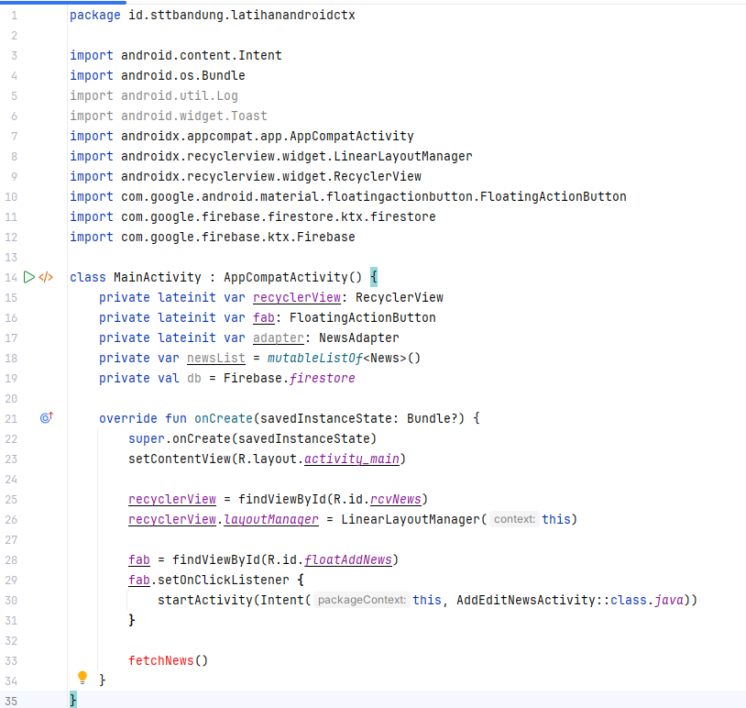
Create Data
Pada MainActivity identifikasi RecyclerView dan FloatingButton. Tambahkan method onClick pada floatingbutton

Slide 15
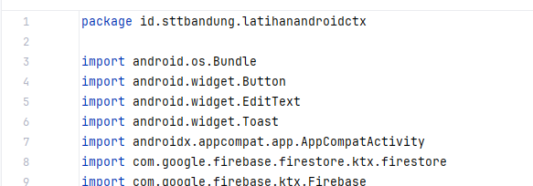
Create Data
Pada AddEditNewsActivity tambahkan library berikut. Dapat copy source di bawah ini:
import android.os.Bundle
import android.widget.Button
import android.widget.EditText
import android.widget.Toast
import androidx.appcompat.app.AppCompatActivity
import com.google.firebase.firestore.ktx.firestore
import com.google.firebase.ktx.Firebase

Slide 16
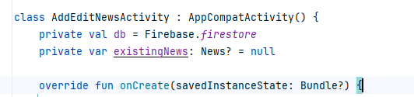
Create Data
Pada AddEditNewsActivity Identifikasi Firebase dan News (Data Class)

Slide 17
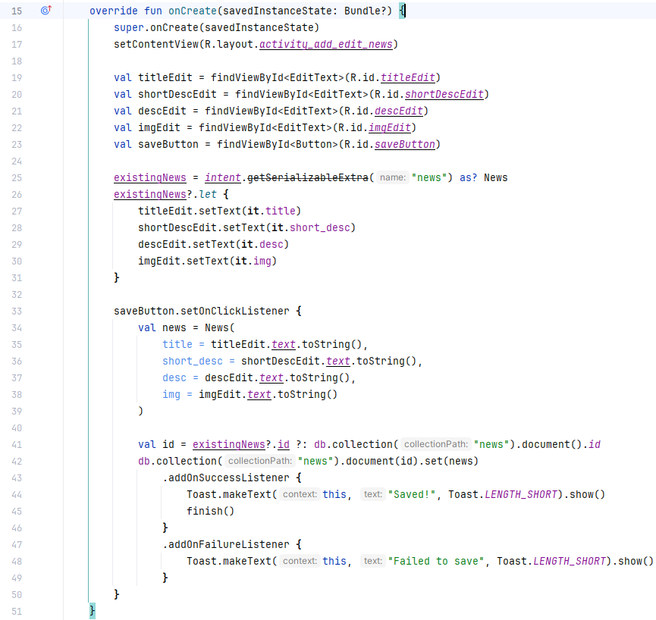
Create Data
Inisialisasi view yang ada pada AddEditNewsActivity.
Kemudian:
Terima intent yang diterima MainActivity dengan nama news
Beri event pada saveButton (untuk menyimpan data atau perubahan data)

Slide 18
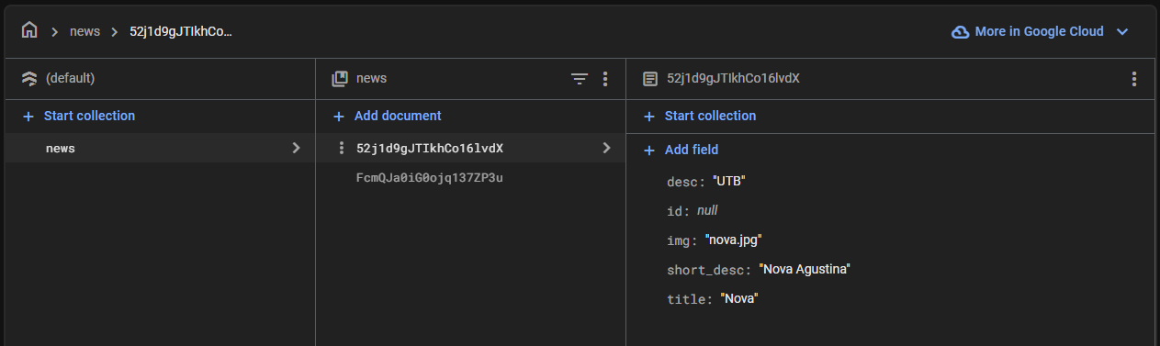
Create Data
Jalankan aplikasi. Jika berhasil, data akan bertambah pada database Firestore

Slide 19
CRUD Firestore (READ DATA)

Slide 20
Read Data
Pada NewsAdapter, lengkapi
import android.view.LayoutInflater import android.view.View import android.view.ViewGroup import android.widget.ImageView import android.widget.TextView import androidx.recyclerview.widget.RecyclerView import com.bumptech.glide.Glide class NewsAdapter( private val newsList: List<News>, private val onItemClick: (News) -> Unit, private val onDeleteClick: (News) -> Unit ) : RecyclerView.Adapter<NewsAdapter.NewsViewHolder>() { inner class NewsViewHolder(view: View) : RecyclerView.ViewHolder(view) { val gambar = view.findViewById<ImageView>(R.id.imgNews) val judul = view.findViewById<TextView>(R.id.titleText) val shortDesc = view.findViewById<TextView>(R.id.shortDescText) val dect = view.findViewById<TextView>(R.id.dectText) val deleteIcon = view.findViewById<ImageView>(R.id.deleteIcon) } override fun onCreateViewHolder(parent: ViewGroup, viewType: Int): NewsViewHolder { val view = LayoutInflater.from(parent.context) .inflate(R.layout.item_news, parent, false) return NewsViewHolder(view) } override fun onBindViewHolder(holder: NewsViewHolder, position: Int) { val news = newsList[position] holder.judul.text = news.title holder.shortDesc.text = news.short_desc holder.dect.text = news.desc Glide.with(holder.itemView.context).load(news.img).into(holder.gambar) holder.itemView.setOnClickListener { onItemClick(news) } holder.deleteIcon.setOnClickListener { onDeleteClick(news) } } override fun getItemCount() = newsList.size }

Slide 21
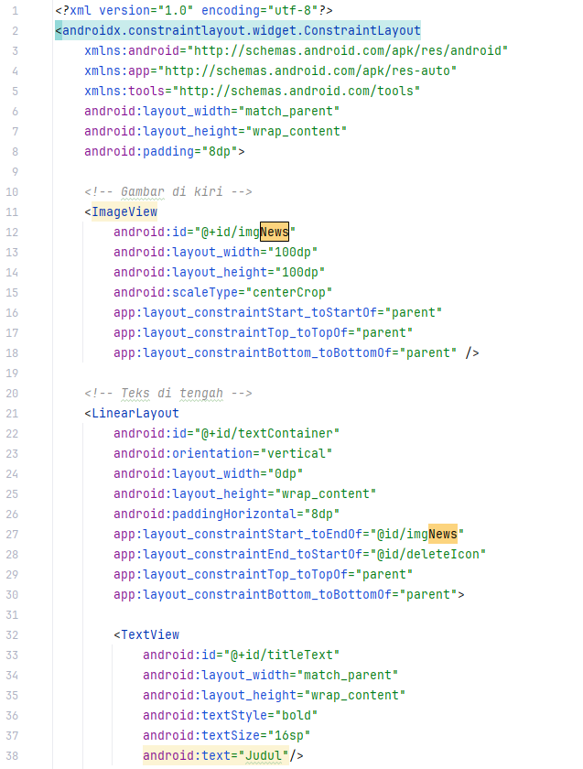
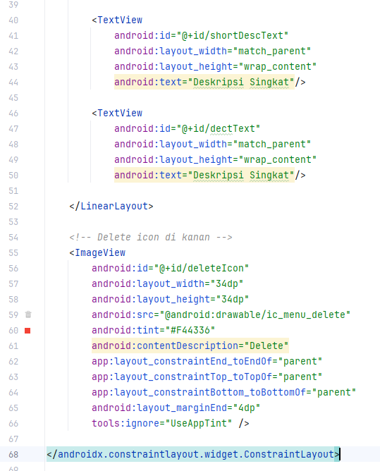
Read Data
Pada item_news.xml
<?xml version="1.0" encoding="utf-8"?>
<androidx.constraintlayout.widget.ConstraintLayout
xmlns:android="http://schemas.android.com/apk/res/android"
xmlns:app="http://schemas.android.com/apk/res-auto"
xmlns:tools="http://schemas.android.com/tools"
android:layout_width="match_parent"
android:layout_height="wrap_content"
android:padding="8dp">
<!-- Gambar di kiri -->
<ImageView
android:id="@+id/imgNews"
android:layout_width="100dp"
android:layout_height="100dp"
android:scaleType="centerCrop"
app:layout_constraintStart_toStartOf="parent"
app:layout_constraintTop_toTopOf="parent"
app:layout_constraintBottom_toBottomOf="parent" />
<!-- Teks di tengah -->
<LinearLayout
android:id="@+id/textContainer"
android:orientation="vertical"
android:layout_width="0dp"
android:layout_height="wrap_content"
android:paddingHorizontal="8dp"
app:layout_constraintStart_toEndOf="@id/imgNews"
app:layout_constraintEnd_toStartOf="@id/deleteIcon"
app:layout_constraintTop_toTopOf="parent"
app:layout_constraintBottom_toBottomOf="parent">
<TextView
android:id="@+id/titleText"
android:layout_width="match_parent"
android:layout_height="wrap_content"
android:textStyle="bold"
android:textSize="16sp"
android:text="Judul"/>
<TextView
android:id="@+id/shortDescText"
android:layout_width="match_parent"
android:layout_height="wrap_content"
android:text="Deskripsi Singkat"/>
<TextView
android:id="@+id/dectText"
android:layout_width="match_parent"
android:layout_height="wrap_content"
android:text="Deskripsi Singkat"/>
</LinearLayout>
<!-- Delete icon di kanan -->
<ImageView
android:id="@+id/deleteIcon"
android:layout_width="34dp"
android:layout_height="34dp"
android:src="@android:drawable/ic_menu_delete"
android:tint="#F44336"
android:contentDescription="Delete"
app:layout_constraintEnd_toEndOf="parent"
app:layout_constraintTop_toTopOf="parent"
app:layout_constraintBottom_toBottomOf="parent"
android:layout_marginEnd="4dp"
tools:ignore="UseAppTint" />
</androidx.constraintlayout.widget.ConstraintLayout>

Slide 22
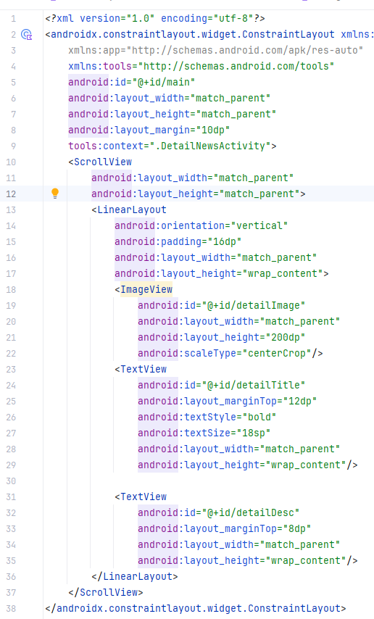
Read Data
Pada activity_detail_news.xml
<?xml version="1.0" encoding="utf-8"?>
<androidx.constraintlayout.widget.ConstraintLayout xmlns:android="http://schemas.android.com/apk/res/android"
xmlns:app="http://schemas.android.com/apk/res-auto"
xmlns:tools="http://schemas.android.com/tools"
android:id="@+id/main"
android:layout_width="match_parent"
android:layout_height="match_parent"
android:layout_margin="10dp"
tools:context=".DetailNewsActivity">
<ScrollView
android:layout_width="match_parent"
android:layout_height="match_parent">
<LinearLayout
android:orientation="vertical"
android:padding="16dp"
android:layout_width="match_parent"
android:layout_height="wrap_content">
<ImageView
android:id="@+id/detailImage"
android:layout_width="match_parent"
android:layout_height="200dp"
android:scaleType="centerCrop"/>
<TextView
android:id="@+id/detailTitle"
android:layout_marginTop="12dp"
android:textStyle="bold"
android:textSize="18sp"
android:layout_width="match_parent"
android:layout_height="wrap_content"/>
<TextView
android:id="@+id/detailDesc"
android:layout_marginTop="8dp"
android:layout_width="match_parent"
android:layout_height="wrap_content"/>
</LinearLayout>
</ScrollView>
</androidx.constraintlayout.widget.ConstraintLayout>

Slide 23
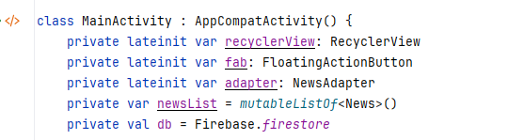
Read Data
Tambahkan FirebaseFirestore, NewsAdapter pada MainActivity sebelum method onCreate.

Slide 24
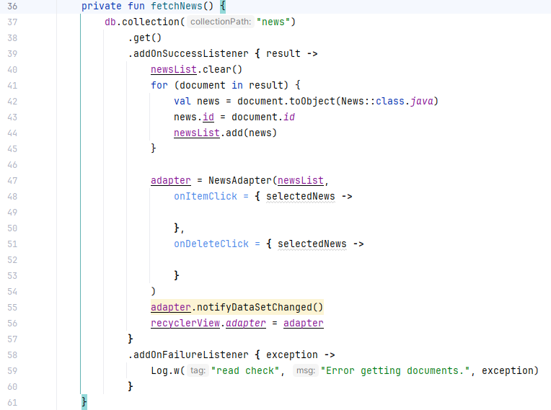
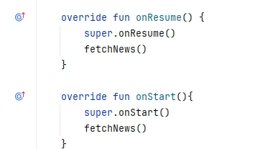
Read Data
Pada MainActivity, buat function fetchNews, override onResume, dan override onStart

Slide 25
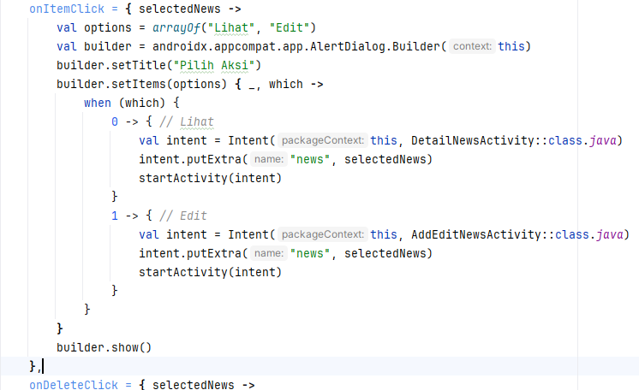
Read Data
Lengkapi fetchNews pada onItemClick
Lengkapi fetchNews pada onDeleteClick

Slide 26
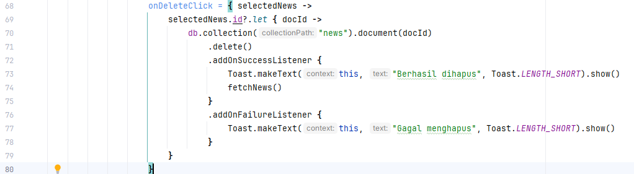
Read Data
Lengkapi fetchNews pada onDeleteClick

Slide 27
Read Data
import android.content.Intent
import android.os.Bundle
import android.util.Log
import android.widget.Toast
import androidx.appcompat.app.AppCompatActivity
import androidx.recyclerview.widget.LinearLayoutManager
import androidx.recyclerview.widget.RecyclerView
import com.google.android.material.floatingactionbutton.FloatingActionButton
import com.google.firebase.firestore.ktx.firestore
import com.google.firebase.ktx.Firebase
class MainActivity : AppCompatActivity() {
private lateinit var recyclerView: RecyclerView
private lateinit var fab: FloatingActionButton
private lateinit var adapter: NewsAdapter
private var newsList = mutableListOf<News>()
private val db = Firebase.firestore
override fun onCreate(savedInstanceState: Bundle?) {
super.onCreate(savedInstanceState)
setContentView(R.layout.activity_main)
recyclerView = findViewById(R.id.rcvNews)
recyclerView.layoutManager = LinearLayoutManager(this)
fab = findViewById(R.id.floatAddNews)
fab.setOnClickListener {
startActivity(Intent(this, AddEditNewsActivity::class.java))
}
fetchNews()
}
private fun fetchNews() {
db.collection("news")
.get()
.addOnSuccessListener { result ->
newsList.clear()
for (document in result) {
val news = document.toObject(News::class.java)
news.id = document.id
newsList.add(news)
}
adapter = NewsAdapter(newsList,
onItemClick = { selectedNews ->
val options = arrayOf("Lihat", "Edit")
val builder = androidx.appcompat.app.AlertDialog.Builder(this)
builder.setTitle("Pilih Aksi")
builder.setItems(options) { _, which ->
when (which) {
0 -> { // Lihat
val intent = Intent(this, DetailNewsActivity::class.java)
intent.putExtra("news", selectedNews)
startActivity(intent)
}
1 -> { // Edit
val intent = Intent(this, AddEditNewsActivity::class.java)
intent.putExtra("news", selectedNews)
startActivity(intent)
}
}
}
builder.show()
},
onDeleteClick = { selectedNews ->
selectedNews.id?.let { docId ->
db.collection("news").document(docId)
.delete()
.addOnSuccessListener {
Toast.makeText(this, "Berhasil dihapus", Toast.LENGTH_SHORT).show()
fetchNews()
}
.addOnFailureListener {
Toast.makeText(this, "Gagal menghapus", Toast.LENGTH_SHORT).show()
}
}
}
)
adapter.notifyDataSetChanged()
recyclerView.adapter = adapter
}
.addOnFailureListener { exception ->
Log.w("read check", "Error getting documents.", exception)
}
}
override fun onResume() {
super.onResume()
fetchNews()
}
override fun onStart(){
super.onStart()
fetchNews()
}
}
Source Lengkap MainActivity

Slide 28
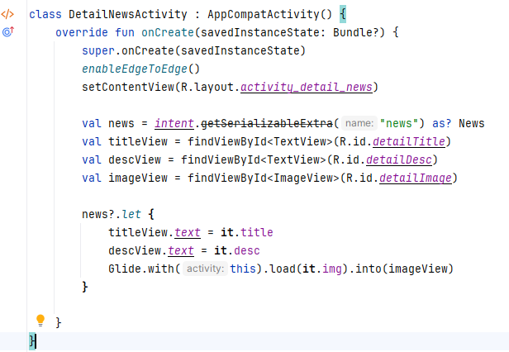
Read Data
Source Lengkap DetailActivity
package id.sttbandung.latihanandroidctx
import android.os.Bundle
import android.widget.ImageView
import android.widget.TextView
import androidx.activity.enableEdgeToEdge
import androidx.appcompat.app.AppCompatActivity
import com.bumptech.glide.Glide
class DetailNewsActivity : AppCompatActivity() {
override fun onCreate(savedInstanceState: Bundle?) {
super.onCreate(savedInstanceState)
enableEdgeToEdge()
setContentView(R.layout.activity_detail_news)
val news = intent.getSerializableExtra("news") as? News
val titleView = findViewById<TextView>(R.id.detailTitle)
val descView = findViewById<TextView>(R.id.detailDesc)
val imageView = findViewById<ImageView>(R.id.detailImage)
news?.let {
titleView.text = it.title
descView.text = it.desc
Glide.with(this).load(it.img).into(imageView)
}
}
}

